Slide 1





Restaurant Data Analysis
This presentation will dive into a comprehensive analysis of restaurant data, uncovering insights that can help optimize operations, enhance customer experiences, and drive business growth.
by Revathi

Slide 2

Introduction to the Dataset
Data Source
Data Scope
Data Types
The dataset includes sales, customer, and operational data from a popular restaurant chain over the past 3 years.
The analysis covers 15 restaurant locations across 3 different cities, providing a robust sample for insights.
The data includes information on menu items, pricing, customer demographics, table turnover, and more.

Slide 3

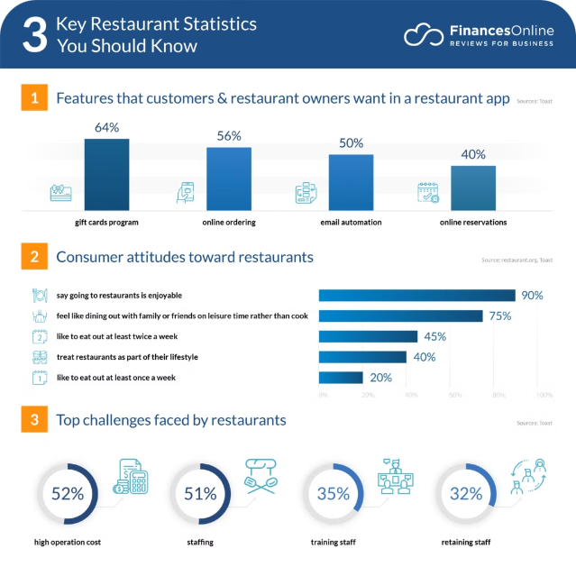
Exploratory Data Analysis
1
Data Cleaning
Ensuring the data is accurate, complete, and consistent for reliable insights.
2
Trend Identification
Uncovering sales, customer, and operational patterns over time.
3
Correlation Analysis
Identifying relationships between various data points to uncover underlying drivers.

Slide 4
Customer Segmentation
Demographic Analysis
Behavioral Patterns
Personalized Targeting
Examining customer age, income, and other characteristics to identify target segments.
Understanding customer visit frequency, spending habits, and menu preferences.
Developing tailored marketing and menu strategies for each customer segment.

Slide 5

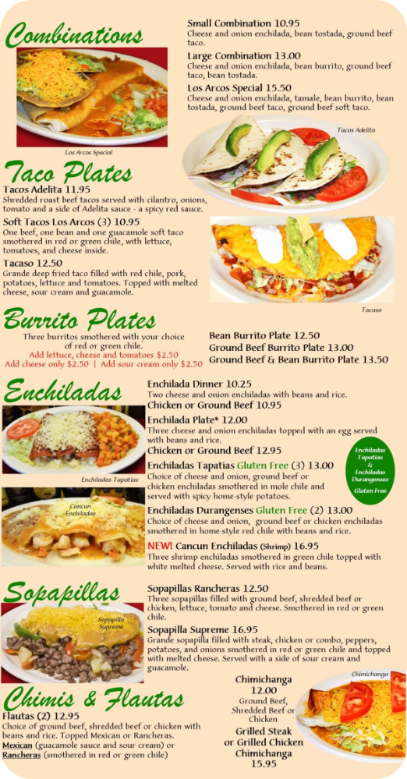
Identifying Popular Dishes
1
Best Sellers
2
Trending Dishes
Analyzing sales data to determine the most popular menu items across locations.
Identifying new or seasonal dishes that are gaining popularity with customers.
3
Signature Items
4
Customization Opportunities
Highlighting the restaurant's unique, signature dishes that drive customer loyalty.
Finding menu items that could be expanded with additional customization options.

Slide 6

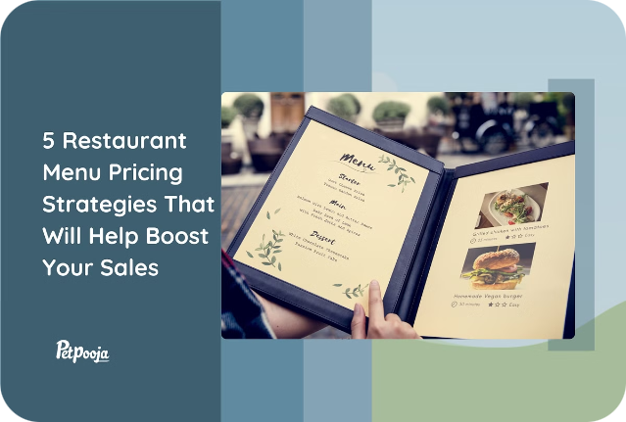
Analyzing Pricing Strategies
Price Elasticity
Competitive Benchmarking
Determining how customer demand changes with price adjustments for each menu item.
Comparing prices with similar restaurants in the market to ensure competitiveness.
Profit Optimization
Dynamic Pricing
Identifying the optimal pricing sweet spot to maximize profitability for each dish.
Exploring the potential for variable pricing based on demand, time of day, or seasonality.

Slide 7
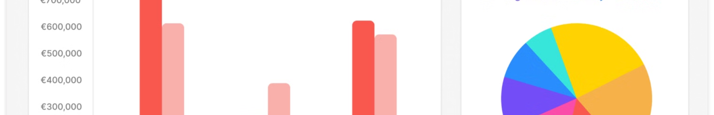
Evaluating Operational Efficiency
Metric
Current Performance
Industry Benchmark
Improvement Opportunity
Table Turnover Rate
45 minutes
40 minutes
Streamline seating and service processes
Kitchen Productivity
75 dishes/hour
90 dishes/hour
Optimize kitchen workflow and staff training
Food Waste
12% of total inventory
8% of total inventory
Improve demand forecasting and inventory management

Slide 8


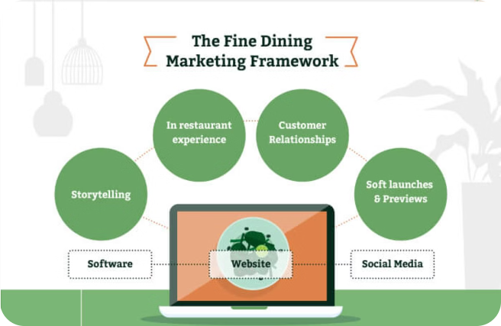


Recommendations and Conclusion
Optimize Pricing
Implement data-driven pricing strategies to maximize profitability.
Enhance Customer Experience
Tailor menu offerings and services to meet the needs of target customer segments.
Improve Operational Efficiency
Streamline processes and workflows to increase productivity and reduce waste.
By leveraging the insights from this comprehensive data analysis, the restaurant can make informed decisions to drive growth, improve customer satisfaction, and achieve operational excellence.

